Slide 1
Analysis of Attention on Text
Summarization Models
Group Members:
Harold Popluhar (st122556)
Omer Farooq Bhatti (st122498)
Amanda Raj Shrestha (st122245)

Slide 2
Objective
Analyse how pretrained transformer model work for text summarization.
Fine-Tuning T5 model with XSum dataset
Visualizing T5 and BART attentions using bertviz library
Analysing T5 model behaviour using ecco library
See how close BART attention behave relative to BERT attention

Slide 3
Literature Review
What does BERT look at? https://arxiv.org/pdf/1906.04341.pdf
Do Transformer Attention Heads Provide Transparency in Abstractive Summarization? https://arxiv.org/pdf/1907.00570.pdf
BART: Denoising Sequence-to-Sequence Pre-training for Natural Language Generation, Translation, and Comprehension https://arxiv.org/abs/1910.13461

Slide 4
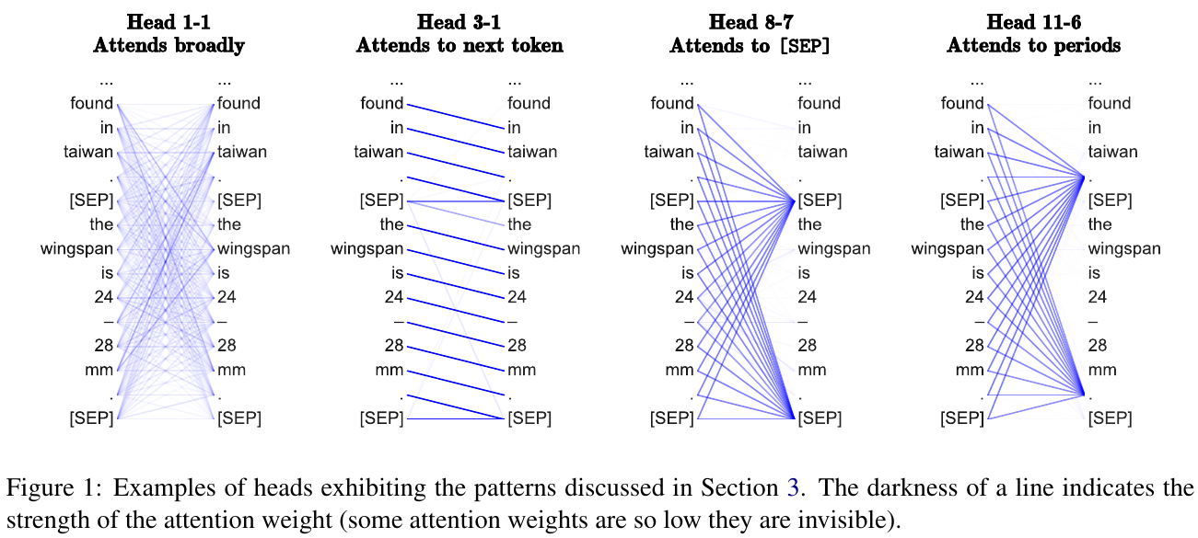
Introduction - Analysis of BERT
Specific attention heads in the model were found to exhibit distinct behavior in BERT for the Text Classification task.
Relative Position
Attending to Separator Tokens
Focused vs Broad Attention

Slide 5
Methodology
We look at the attention heads of the T-5 & BART model to examine what the model is looking at when it summarizes the text.
Perspectives Applied:
i) Behavior of attention heads for Text Classification task versus Text Summarization task
ii) Possibility of use of Attention heads for explainability of the model

Slide 6
Work TBD
Examine BART attention heads for:
Co-reference resolution
Anaphora
Entity Linking
Relative Position
NER
Dependency Parsing
POS tagging, etc
Use Input example using Synonyms, Antonyms and compare/contrast attention weights/outputs.
(Optional) see if we can change the attention weights somehow and observe model output.
https://arxiv.org/abs/1904.02679 - Visualizing attention
https://github.com/flairNLP/flair - Sentence tagging for NER, POS etc

Slide 7
Fine-tuning T5-small model
T5-small model was fine-tuned using the pre-trained model and Trainer API from the huggingface library. XSum dataset was used for fine-tuning the model. The training parameters were as following:
Epochs = 5
Learning rate = 2e-5
Weight decay = 0
Learning rate scheduler = ‘linear’
Optimizer = Adam
Dataset:
Extreme Summarization (XSum) dataset which consists of BBC articles from a range of domains.
Training samples: 204,045

Slide 8
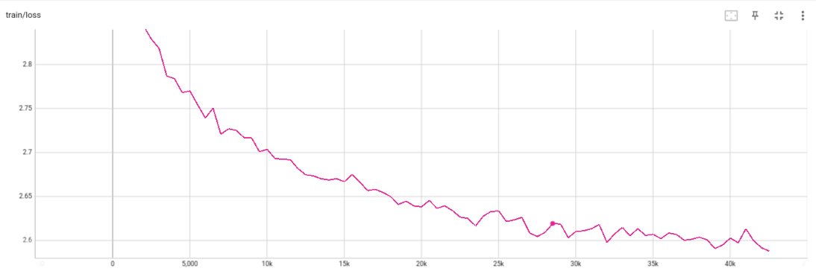
T5 small - Fine-tuning - Training loss

Slide 9
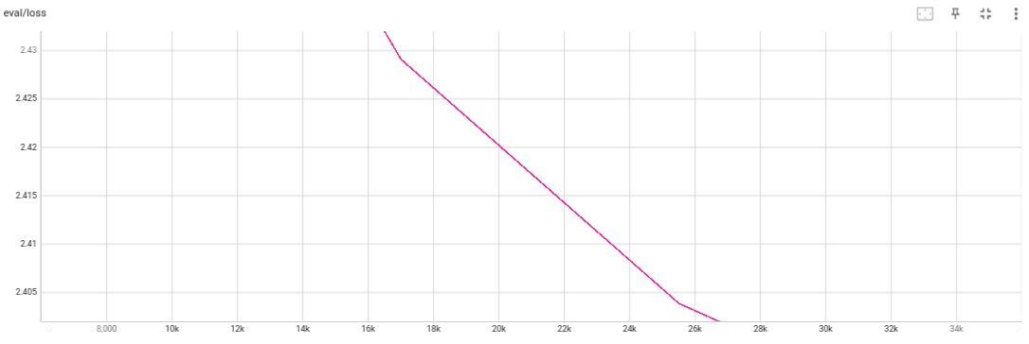
T5 small - Fine-tuning - Validation loss

Slide 10
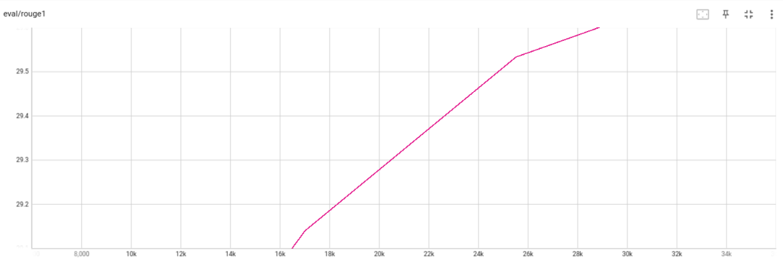
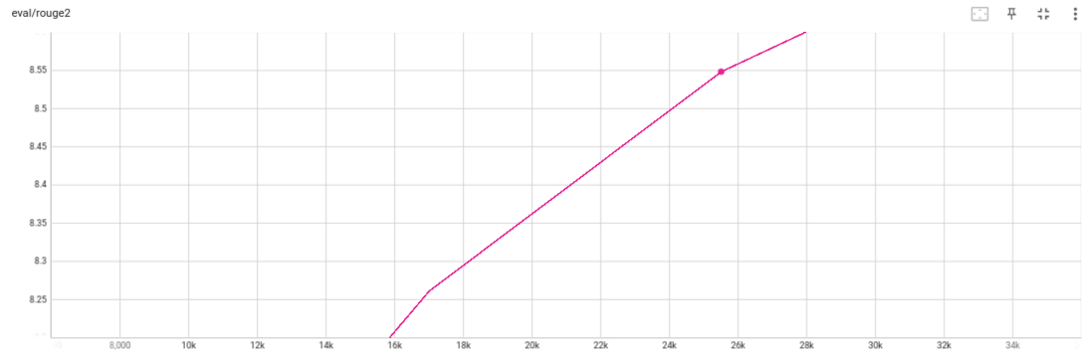
T5 small - Fine-tuning - Rouge1 & Rouge2 scores
Rouge1 score = 29.73
Rouge2 score = 8.77

Slide 11
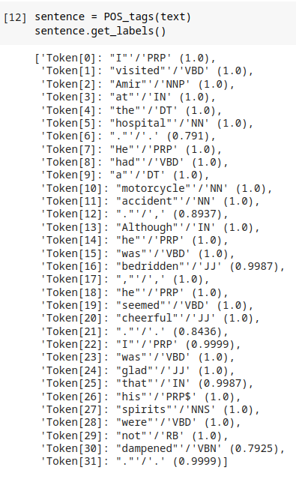
POS tagging
We generate the Parts of Speech tags for our input
sentence using the Flair POS tagger.
Having a tagged input sequence can be useful when examining the model workings to understand which Parts of speech the model is paying attention to.

Slide 12
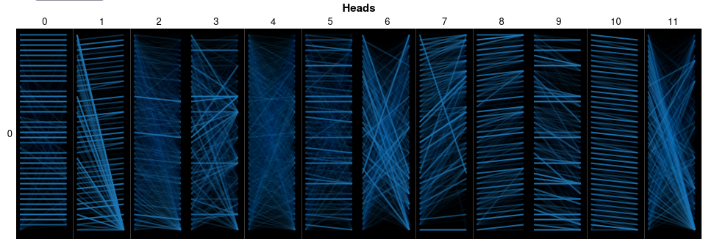
Attention Visualization (T5-base): Encoder Attention
T5-base model has 12 layers and 12 Attn. Heads
Attention Heads of First layer of the Encoder of T5-base model. No task

Slide 13
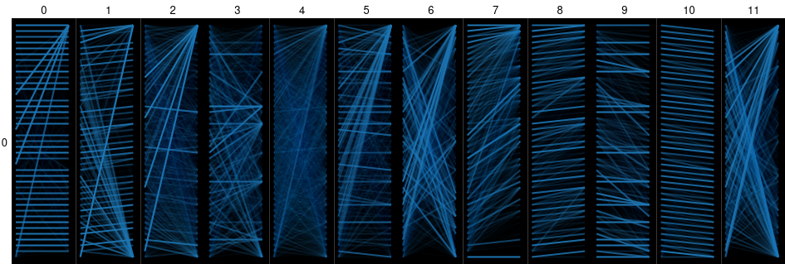
Attention Visualization (T5-base): Encoder Attention
T5-base model has 12 layers and 12 Attn. Heads
Attention Heads of First layer of the Encoder of T5-base model. Summarize task

Slide 14
Attention Visualization (T5-base): Encoder Attention
We can see that the attention heads 1, 2, 5, 8, 9, 10 are attending to relative position.
Head 7 seems to be attending to similar words.
Most of heads exhibit broad attention.
Heads 0, 5, 8, and 10 appear to be a bit more focused attention.
No task
Summarize

Slide 15
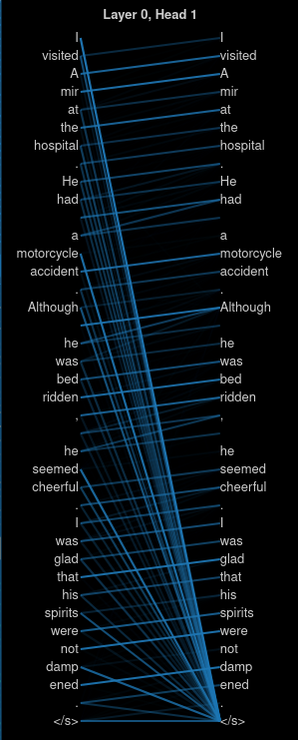
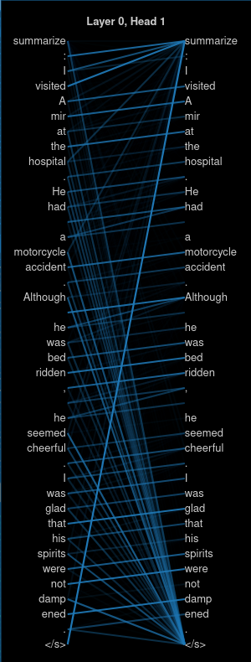
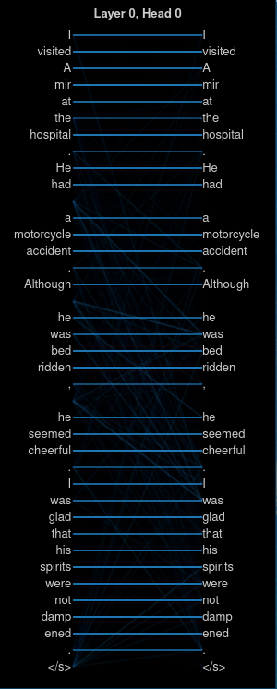
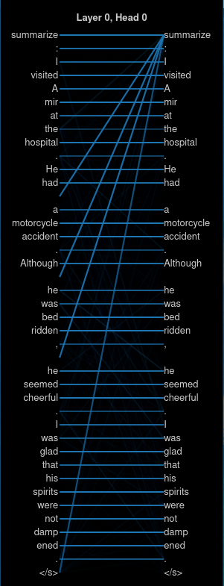
Attention Visualization (T5-base): Encoder Attention
The first attention head seems to mostly be attending to the corresponding input
tokens.
This attention head seems to mostly exhibit the Relative Position behaviour, where each token is attending to previous tokens.
No Task
Summarize

Slide 16
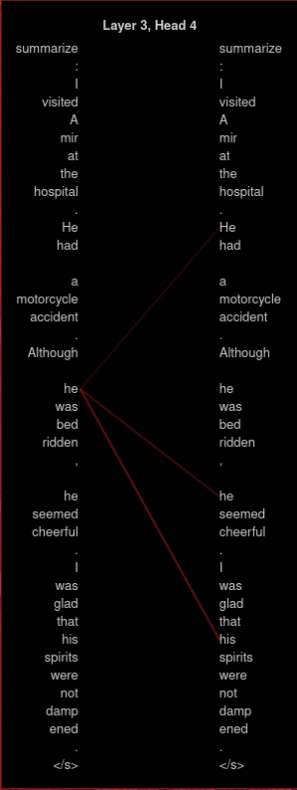
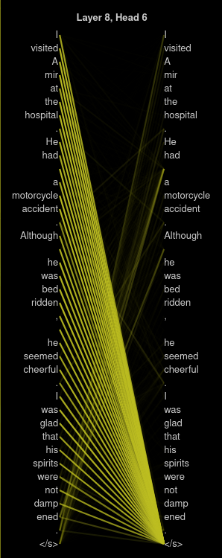
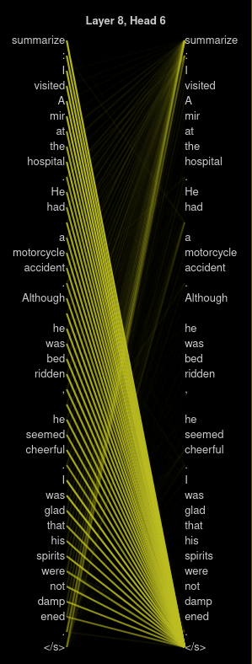
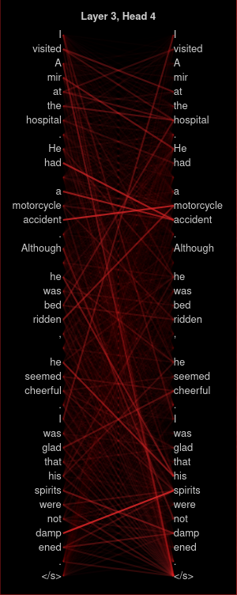
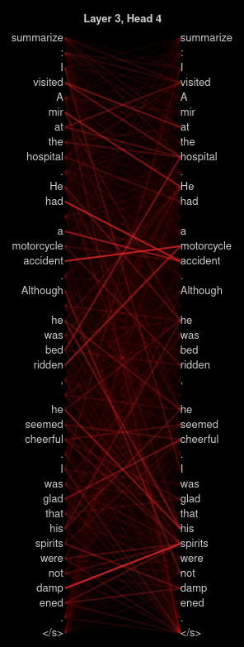
Attention Visualization (T5-base): Encoder Attention
We can also see an example of co-reference resolution, where the token for “Amir” is attending to “He”. And the other tokens for “he” seems to be attending to “he”.
model attentive to </s> token: attention head 6 at layer 8 of the model.
Attention head at layer 3 appears to be attending to Parts of Speech.

Slide 17
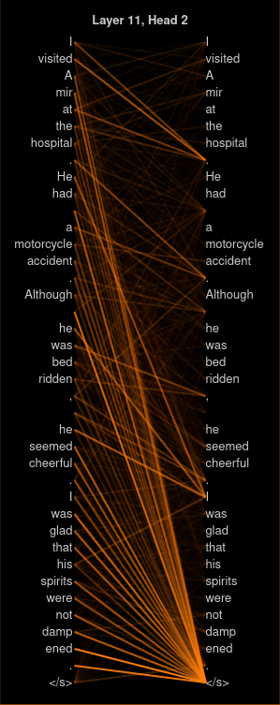
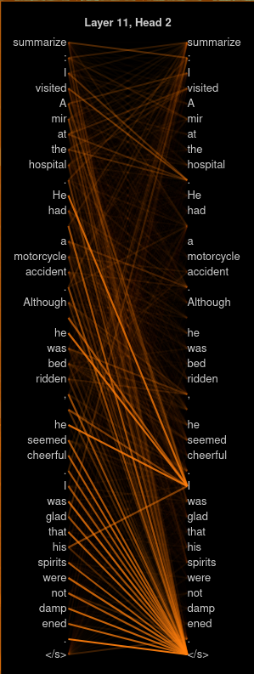
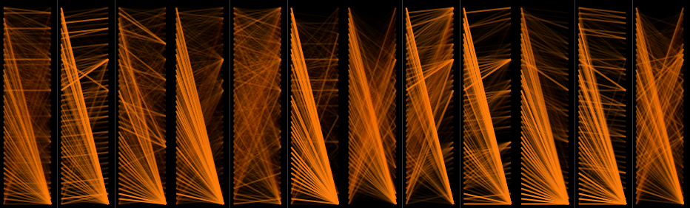
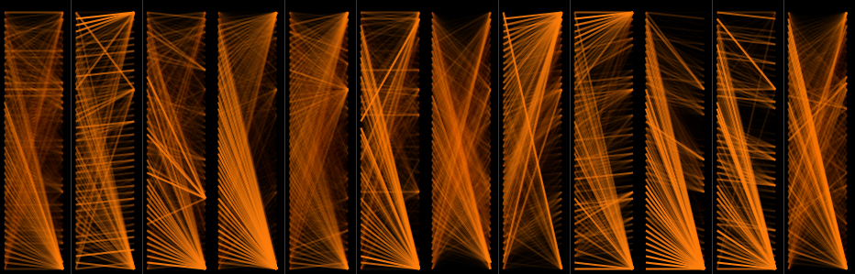
Encoder Attention
A lot of attention is also focused on the end of sentence tag. <s> and punctuation grammar.
Heads in the last layer seem to mainly be attending to the </s> token, relative position, punctuation tokens or summarize tag...
No Task
Summarize

Slide 18
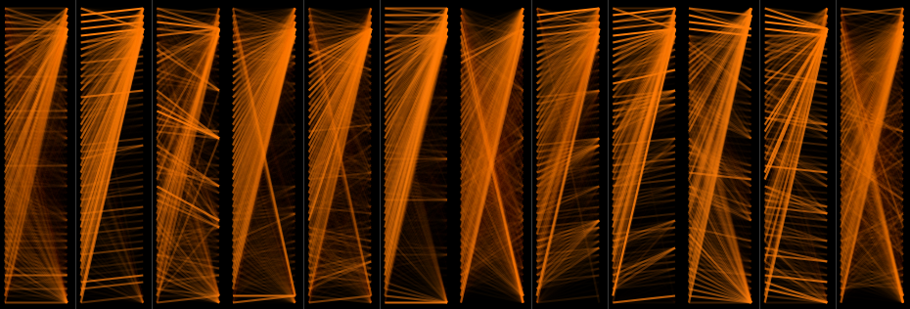
Encoder Attention: English to French
Heads in the last layer seem to be attending more to the task prefix tokens instead of </s>
English to French Translation

Slide 19
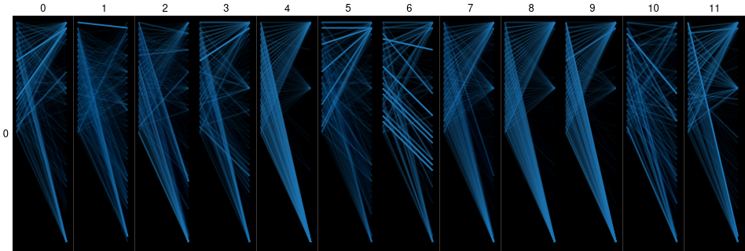
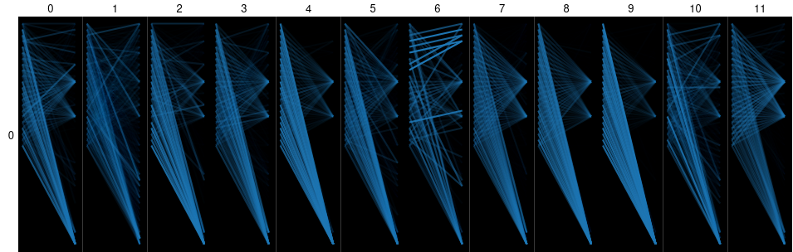
Attention Visualization (T5-base): Cross-Attention
The patterns for the no task and the summarize task are different.
Summarize
In the cross-attention first layer, the model seems to be attending to the relative position and </s> token.
No task

Slide 20
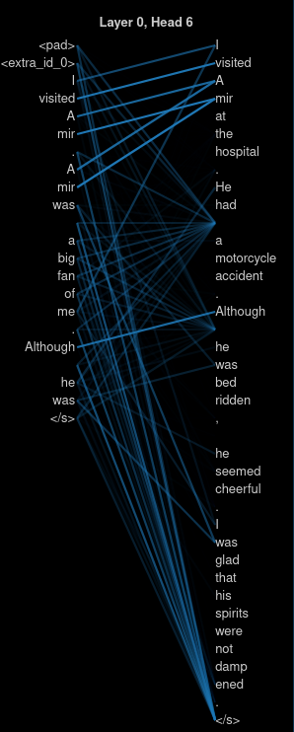
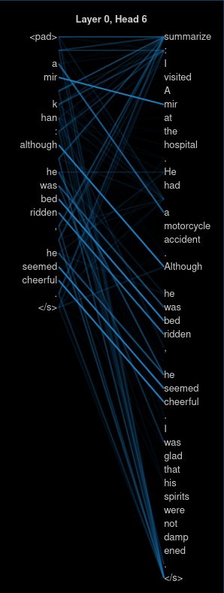
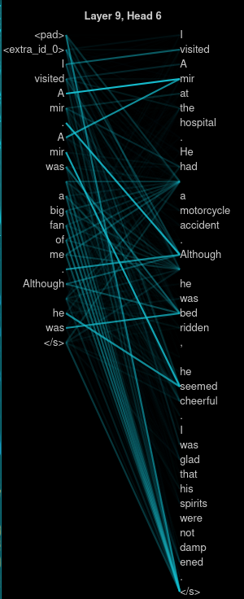
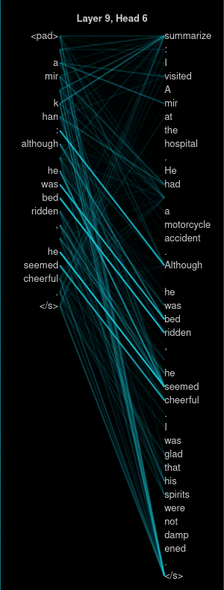
Attention Visualization (T5-base): Cross-Attention
The output tokens attending to same tokens at the input. But the tokens being attended to is different for the No task and summarize task. This may be an example of Extractive Summarization.
Relative Position + Broad General Attention

Slide 21
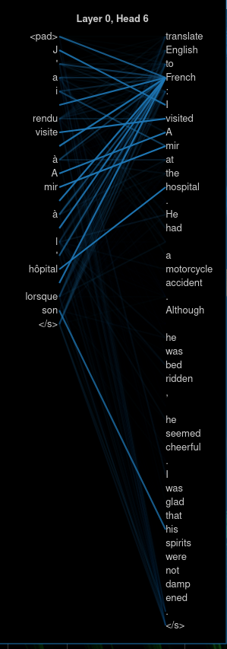
Attention Visualization (T5-base): Cross-Attention
English to French summarization

Slide 22
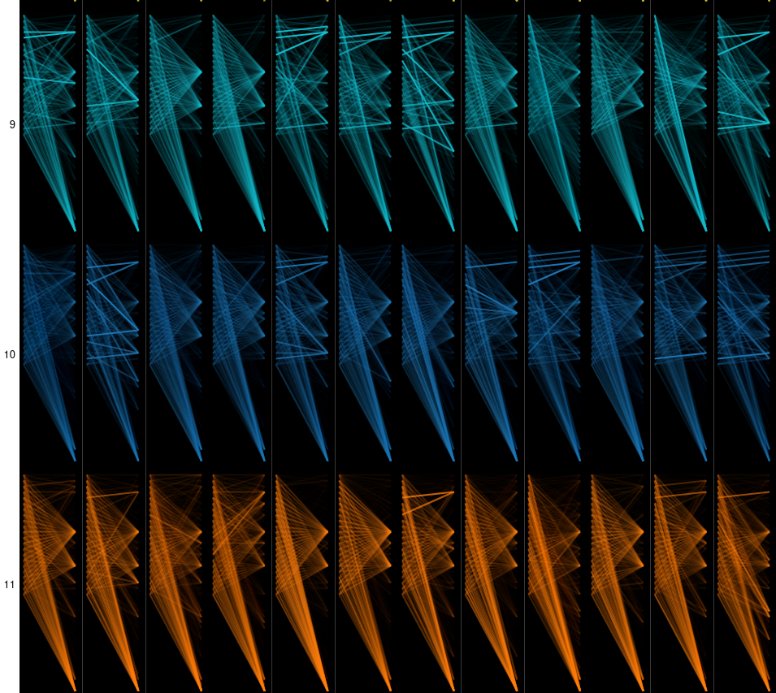
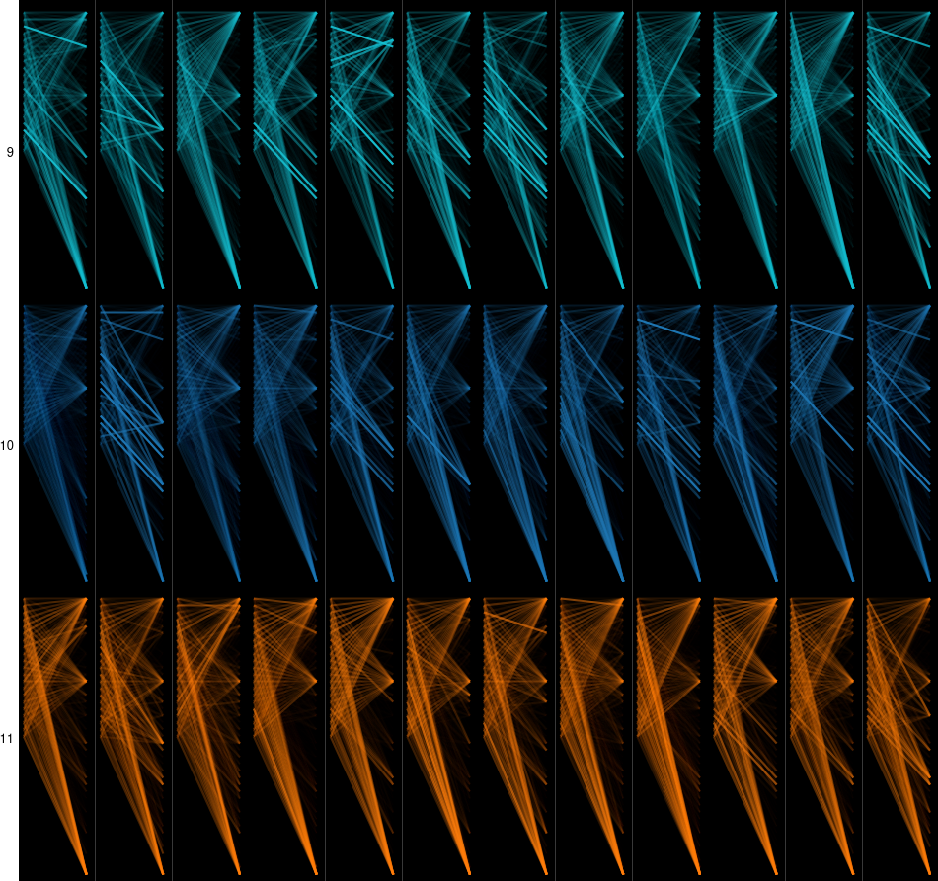
Attention Visualization (T5-base): Cross-Attention
Cross-Attention from last three layers of the model. We can observe that the preceding layers are more broadly attending, the heads in the final layer are mostly attending to “space” and “</s>” tokens
Throughout the cross-attention of the model, most of the heads seem to be attending to the space and </s> tokens mainly. Similar to BERT model, this may represent a no-op.
No task
Summarize

Slide 23
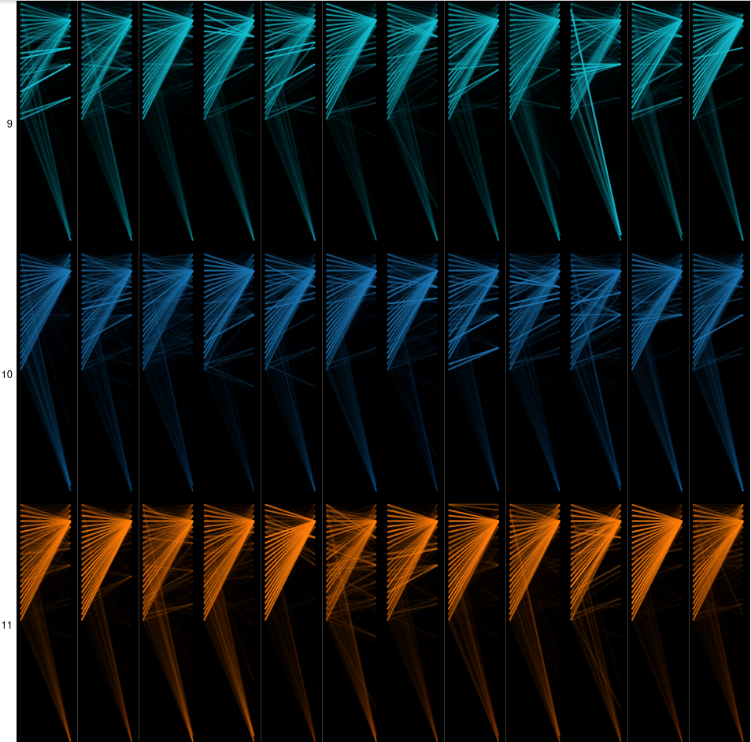
Attention Visualization (T5-base): Cross-Attention
Cross-Attention from last three layers of the model. We can observe that the preceding layers are more broadly attending, the heads in the final layer are mostly attending to “space” and “</s>” tokens along with the task prefix. Although more weight is assigned to the task prefix than the </s> token.
Translate English to French

Slide 24
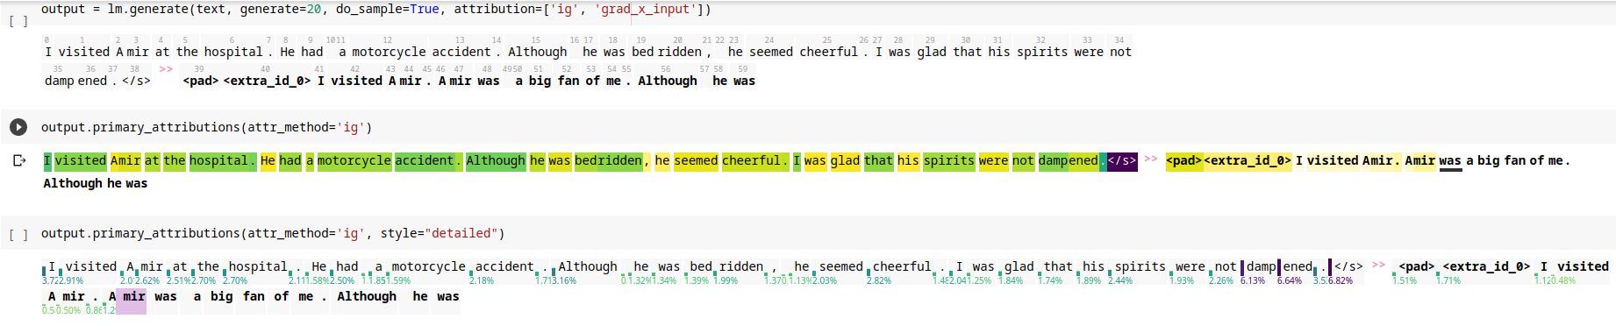
Relative Importance of Input Tokens
using ECCO library for Language Model Understanding: Integrated Gradients
We can see that the output token “mir” selected is dependent upon the three input tokens highlighted.

Slide 25
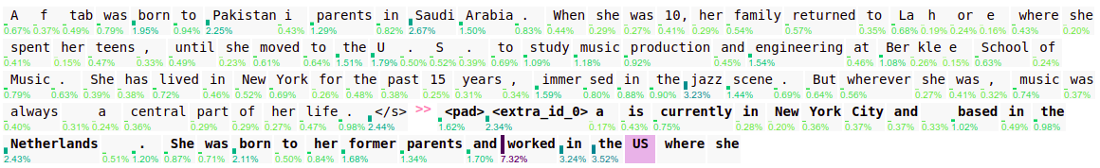
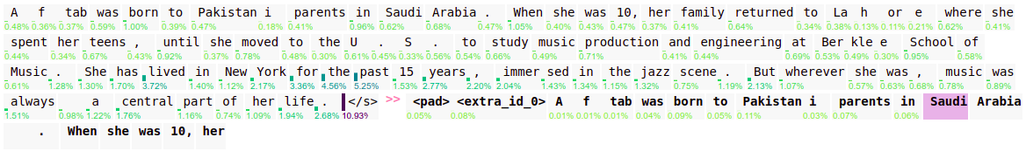
Relative Importance of Input Tokens
Surprisingly, the generation of the US doesn’t seem to be dependent of the presence of the word New York or U.S in the encoder input but on the jazz music.
With the same example, T5 generated a different output. Instead of generating text related to the end of the text, T5 is almost copying the input
The fact that most of the output is depending more about the </s> token than previously can explain the copy behaviour of T5.

Slide 26
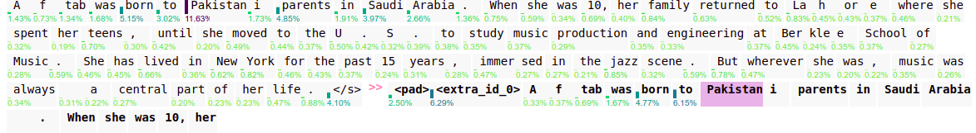
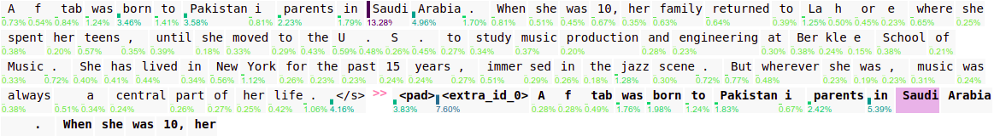
Relative importance of Tokens: Saliency
In our case, when most of the text is copied from the encoder, the saliency provide less interpretable information than the integrated gradient.

Slide 27
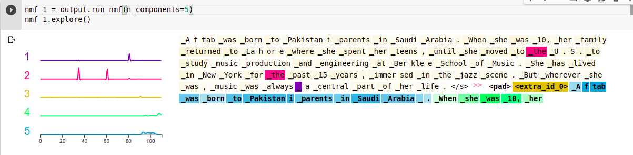
Patterns in the Fully Connected Layer of Transformer
Only one cluster in the encoder input from the Non Negative Matrix Factorization. Can explain why the generation of token is influenced by the token </s>.
Can also maybe explain why the summary the basically copied from the input

Slide 28
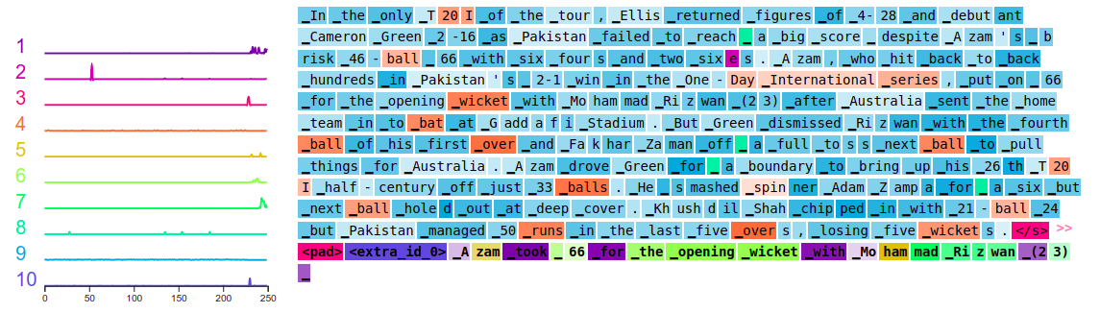
Patterns in T5 neuron activation
One pattern is related to vocabulary related to cricket
Some space tokens have a different pattern
The overall seems to have a common pattern

Slide 29
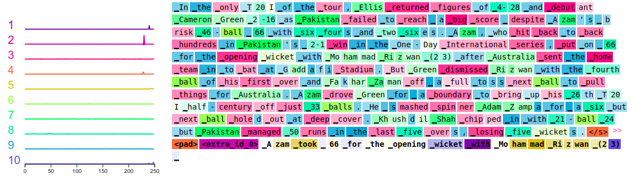
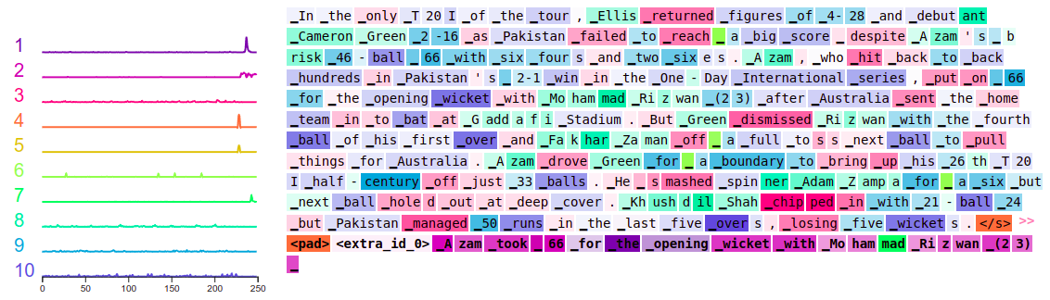
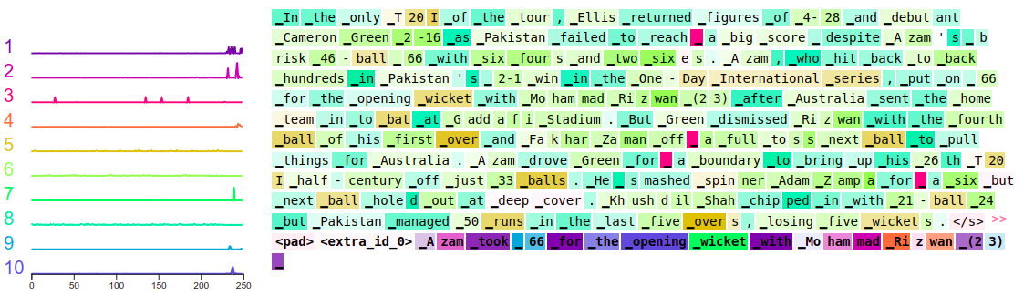
Patterns across the layers
From Layer 0 to Layer 1
The clusterization of the vocabulary related to cricket is build layer by layer.
From Layer 5 to Layer 6
We can easily see this construction with the word wicket and overs at the end of the example
From Layer 10 to Layer 11

Slide 30
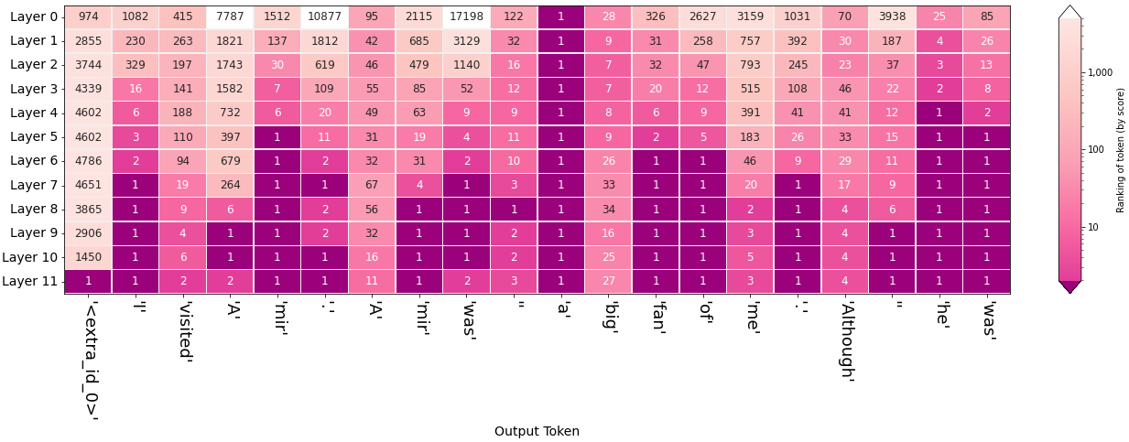
Ranking of output token through model layers
How did the model generate the output token “fan” ?
We can see below that this token is mostly dependent on the preceding token “big”.

Slide 31
Pretrained Model (BART)
BART is a denoising autoencoder that maps a corrupted document to the original document it was derived from. It is implemented as a sequence-to-sequence model with a bidirectional encoder over corrupted text and a left-to-right autoregressive decoder.
The architecture of BART have the following differences with BERT:
Each layer of the decoder additionally performs cross-attention over the final hidden layer of the encoder.
BART does not use an additional feed-forward network.
It contains 10% more parameters than the equivalently sized BERT model
It pre-trains a model combining Bidirectional and Auto-Regressive Transformers.

Slide 32
BART attention analysis.
For the attention analysis of the bart model, we followed the “What Does BERT Look At? An Analysis of BERT’s Attention” paper.
We used the (facebook/bart-large-cnn) model from the hugging face library. https://huggingface.co/facebook/bart-large-cnn
We referenced and modified the code mentioned in the paper to do similar analysis of the BART model
We study some of the differences between the BART and BERT attention behaviours.

Slide 33
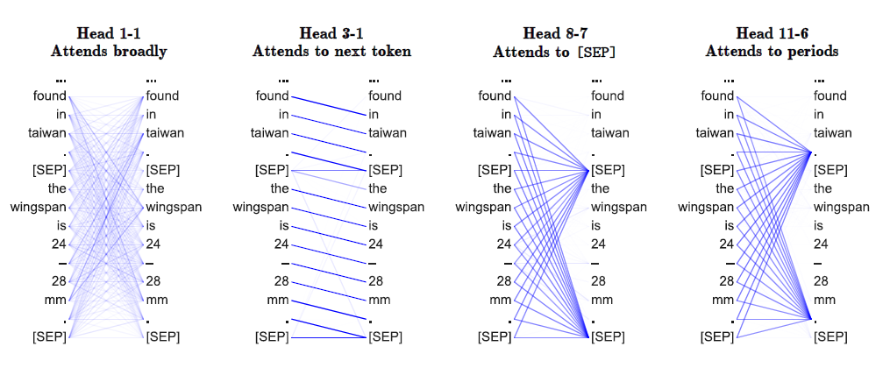
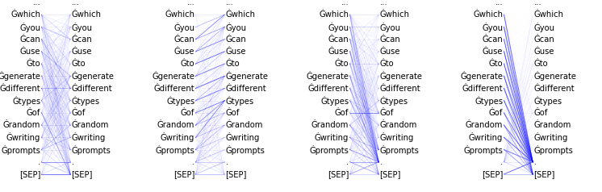
In this figure we see some examples of the heads exhibiting particular patterns.
In the top we see the heads of the BERT model. In the bottom we look at some patterns from the same layer, heads.

Slide 34
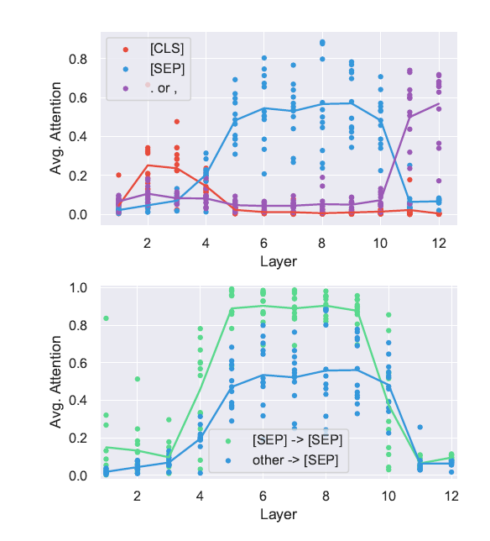
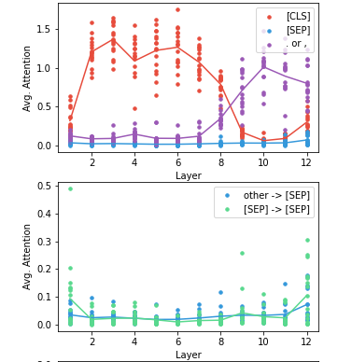
In the left (BERT) we can see that the early heads attend to [CLS], middle heads attends to [SEP] and last heads attends to periods. We can also see that the head attends to [SEP] to [SEP] more.
In the right (BART) we can see that both early and middle heads attend to the [CLS] and the last heads attend to periods.

Slide 35
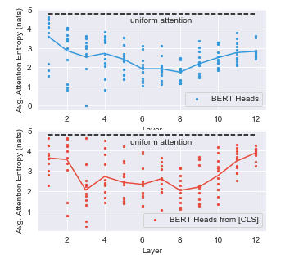
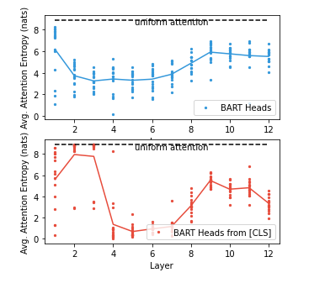
In the paper, they mention that the entropies the last layer are high indicating broad attention in the last layers.
Here we see that the average entropies of BART model (right) is similar to that of the BERT model (left)
The first layers have higher entropies for the [CLS] than the lower layers.

Slide 36
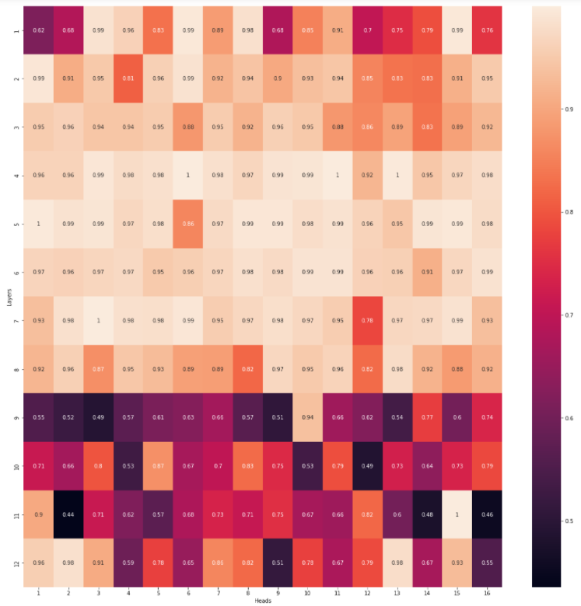
Here we can see the heatmap of the maximum attention of heads with the corresponding layer.
We can see that the maximum attention value is low in the lower layer. This may also indicate that the attentions are broader in the lower layer.

Slide 37


Here we use the Jensen-Shannon Divergence to get the distance between attention distributions. We then cluster the BART attention heads into 2 dimensional space.

Slide 38


Here we analyse the relative positioning of the encoder and decoder attention of the model. We see how often the maximum attention weight is on preceding or successive tokens relative to the current token. It seems that not much heads focus on relative positions.
Encoder Attention
Decoder Attention

Slide 39



Other visualization of attention weights
Model BART-Base from Facebook
Raw attention
Attention rollout
Attention flow
We can still see the dominance of [CLS] token for BART model in the raw and rollout attention
No dominant tokens can be observed from the attention flow graph, no input tokens are important for the prediction.
MASK token has the same behaviour than other tokens
From the raw attention map, the most
we get deep, the most the information is
contextualized. Many of them carry
the same kind of information.

Slide 40



Raw attention
Model Bert-base-uncased
Attention rollout
Attention flow

Slide 41
Limitations
Fine tuning on large models such as BART-large could not be done because of lack of computational resources.
Lack of domain knowledge.

Slide 42
What we learned.
BART and BERT models have similar attention behaviour.
The attentions in BART model are broader in lower layers.
Most of the Attention in T5-base seems to be on the </s> token for summarization task. This seems to be a noop option.
The output generated for our input tokens was mostly copied from the input sentence, with some additional words generated, and the behaviour of the attention in the model seems to verify that.
The attention of the T5 model changes based on the preceding task prefix supplied to the model.

Slide 43
Conclusion
The attention behaviour of BART and BERT models are mostly similar. Since BART is BERT based, that means that the training procedure doesn’t modify the attention behaviour of a model in considering ways.
In case of BART the attention focus mostly on the starting token [CLS] rather than the ending token [SEP] whereas the BERT focuses mostly on the [SEP] token. Attention on both of these models are broad especially on the lower layers.
With the T5 model, the cross-attention in the model changes based on the task prefix supplied to the model. The attention patterns in the encoder are broadly similar except for the addition of patterns relating to the task prefix.
The model also seems to focus a lot on the end token </s>. The attention on </s> seems to be similar to a noop. However, there is less attention to the </s> token for the machine translation task than for the summarization task.

Slide 44
Thank You!

